Slide 1







Data Analysis
Nav
27/03/24

Slide 2



OUTLINE
Executive Summary
Introduction
Methodology
Results
Visualization – Charts
Dashboard
Discussion
Findings & Implications
Conclusion
Appendix

Slide 3

EXECUTIVE SUMMARY
Programming Language and Database Trends
Demographics Survey Analysis
Bridging the Technological Gap Across Nations
Addressing Gender Disparity in the Workforce

Slide 4

INTRODUCTION
Assessing skill demands for the future workforce
Identifying sought-after programming languages
Highlighting in-demand database skills
Examining prevalent Integrated Development Environments (IDEs)
Target Audience: Human Resources and IT Management

Slide 5

METHODOLOGY
Sources of Data Collection
Stack Overflow Developer Survey 2019
Job Postings on GitHub
Annual Salary Data for Programming Languages
Exploration of Data
Data Cleansing
Visualization of Data
Presentation

Slide 6
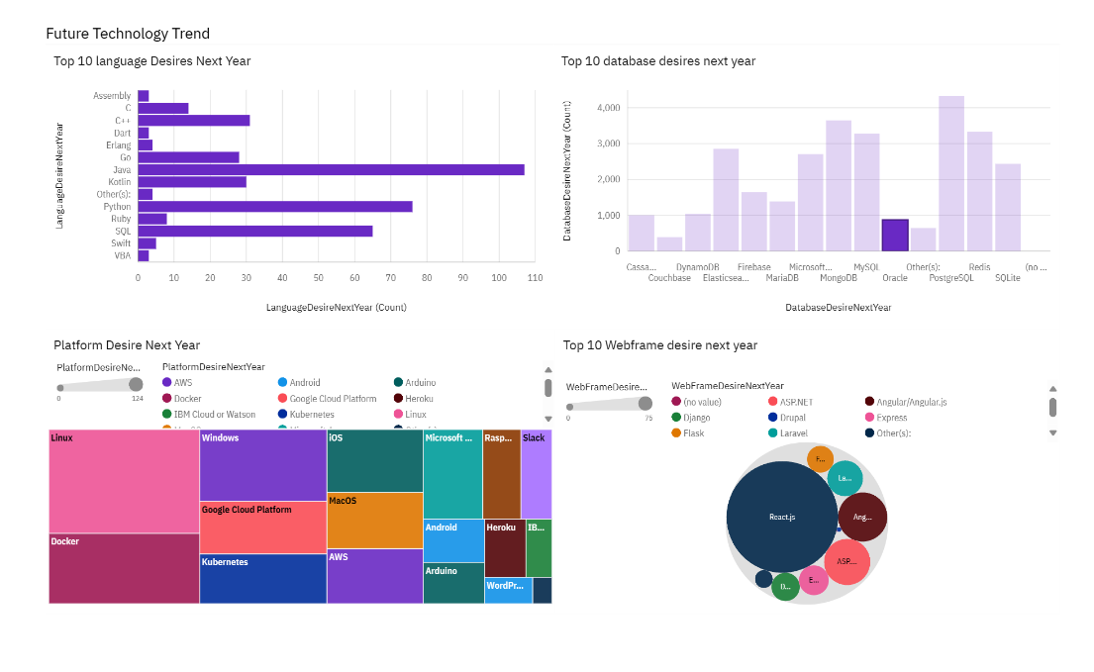
RESULTS

Slide 7
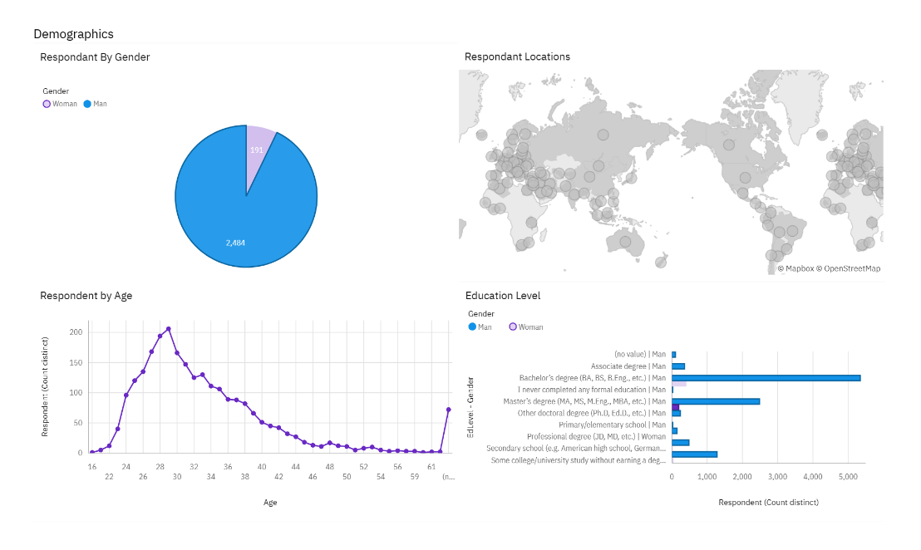
RESULTS

Slide 8
PROGRAMMING LANGUAGE TRENDS - FINDINGS & IMPLICATIONS
Discoveries:
JavaScript, HTML/CSS, and SQL emerge as the top three this year.
Python and TypeScript are anticipated to gain popularity next year.
PowerShell is projected to decline in the upcoming year
Significance:
Continued high demand for web development skills.
SQL remains indispensable in companies utilizing Big Data technologies.
Python stands out as the preferred choice with the increasing demand for AI and ML.

Slide 9
DATABASE TRENDS - FINDINGS & IMPLICATIONS
Discoveries:
MySQL emerges as the most popular database.
Following closely is Microsoft SQL.
MongoDB and Redis are gaining popularity as upcoming favorites.
Elasticsearch is a newcomer in the field.
Implications:
Open-source databases maintain their preference within companies.
NoSQL databases are poised to have a significant impact on storing non-relational data.
Redis offers support for abstract data types.
Elasticsearch provides pre-tuned search capabilities for websites, apps, or ecommerce stores.

Slide 10

DASHBOARD
navreehal04/Building-A-Dashboard-With-IBM-Cognos-Analytics (github.com)

Slide 11
DISCUSSION
Evolution of Technology Trends:
Advancements in Technology: Present and Future
Empowering Workforce through Training and Reskilling
Encouraging Female Engagement in the Technology Sector
Closing the Technological Gap in Developing Nations
Combatting Employment Discrimination based on Age and Education

Slide 12
OVERALL FINDINGS & IMPLICATIONS
Discoveries:
Technology evolves rapidly each year.
There's a notable focus on specific countries such as the USA and India.
Gender disparity persists in technology-related occupations.
Platforms like Docker and AWS experience significant growth.
Implications:
Companies must remain adaptable and accommodate swift technological changes.
Efforts are needed to disseminate technology to underdeveloped regions.
Considerations regarding the impact of hiring practices.
Anticipated shift towards faster application deployments and increased adoption of cloud services in the future.

Slide 13

CONCLUSION
• Current and Future Technology Trends
• Overview of Programming Languages, Databases, and Platforms
• Demographic Insights
• Recommended Actions
• Future Integration of Machine Learning for Trend Prediction and Salary Forecasts

